Slide 1


Economic infrastructure in a new era
FSB Northern Ireland
The impact of a changed relationship with the EU on small businesses

Slide 2




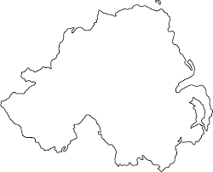
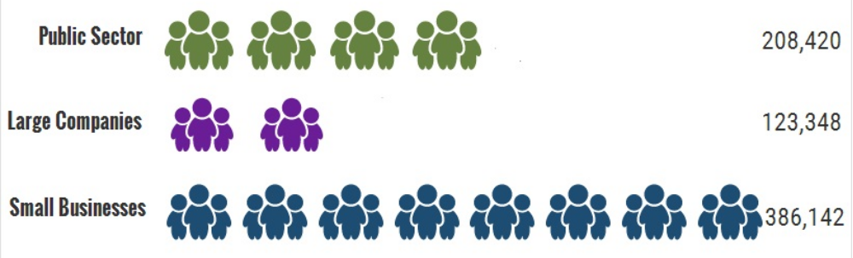
Small business in Northern Ireland
9%
68% employ people from local area
95% do not intend to relocate outside their local area
Economic infrastructure in a new era

Slide 3
FSB and the EU
Maintaining access to the single market
2. Continued access to skilled and seasonal labour
3. Security of EU funding schemes
4. Clarity over the regulatory framework
Economic infrastructure in a new era

Slide 4
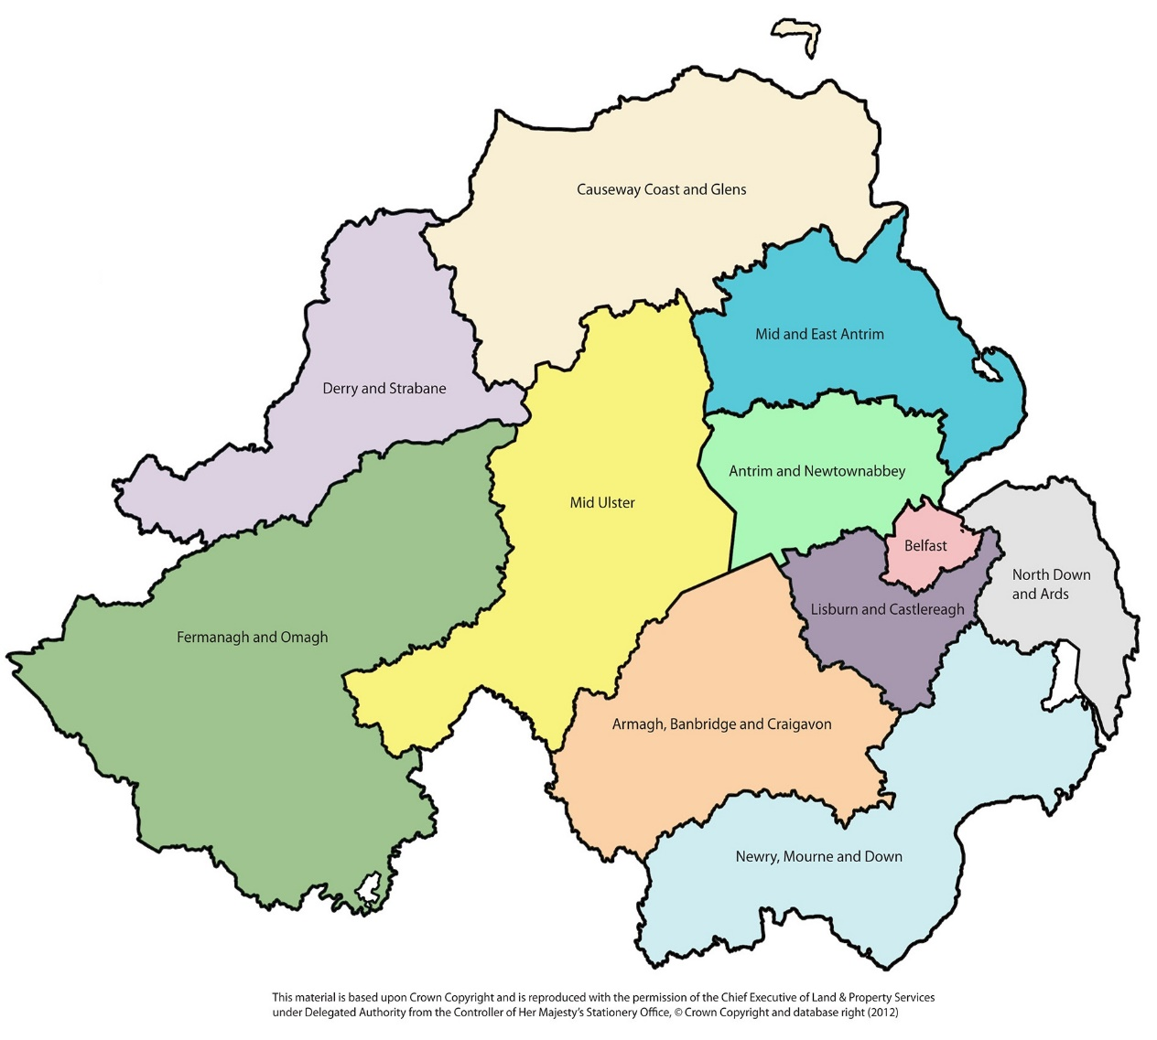
Impact on Northern Ireland
The Border
Re-shaping strategies
Infrastructure projects
Engagement in negotiations
Confidence and stability
Economic infrastructure in a new era

Slide 5
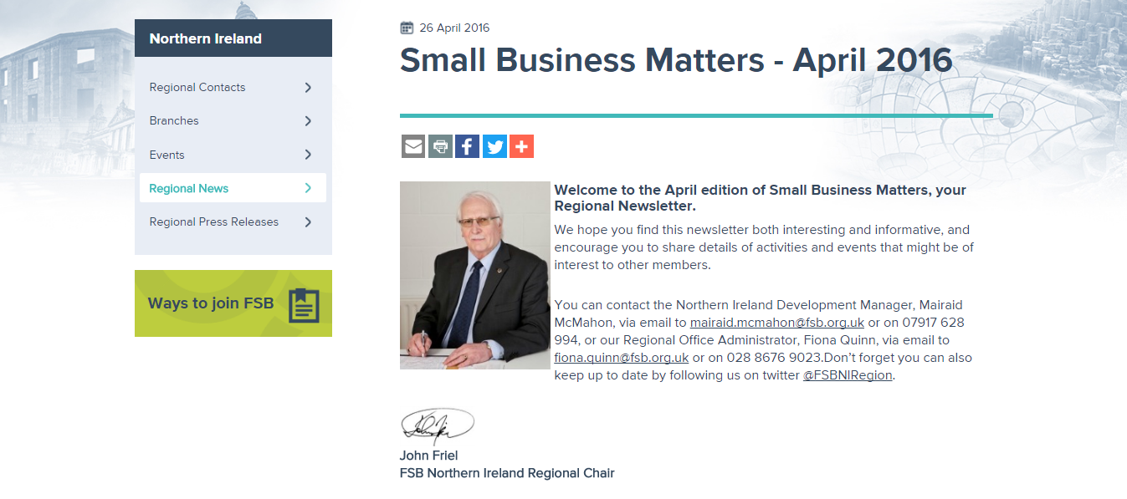


FOR MORE INFORMATION
For further information our team are always keen to engage with you:
Mairaid McMahon
Development Manager, Northern Ireland
T 028 8676 9023
M 07917 628 994
E mairaid.mcmahon@fsb.org.uk
W fsb.org.uk/regions/northern-ireland
@FSBNIRegion
Economic infrastructure in a new era

