Slide 1


Will Brexit stall or break the progress of the Northern Ireland Economy?
Leslie Budd
Implications of Brexit
Conference at Glenavon House Hotel, Cookstown
Thursday 22nd of September 2016

Slide 2
The Issues
“Brexit means Brexit” is a meaningless tautology. We are in the realm of unknown unknowns (Donald Rumsfeld);
Post-Brexit uncertainty undermining growth potential = 0.3% in 2017 (PWC, NI);
Productivity Growth undermined by lower FDI;
Misunderstanding of modern trade and role of Global Value Chains (GVCs) means alternative deals on offer do not take account of this;
Devolved Corporation Tax undermined and damaging unless proper fiscal settlement with The Treasury;
The Border Paradox.

Slide 3

The Mouse Trap?

Slide 4
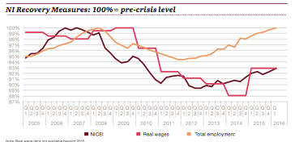
Growth Projections and economic activity
 | 2014 | 2015 | 2016 | 2017
NI | 2.2 | 1.5 | 1.2 | 0.3
UK | 2.9 | 2.3 | 1.8 | 0.7
ROI | 6.0 | 7.8 | 4.5 | 3.3

Slide 5
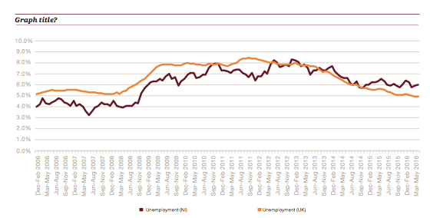
Current Relative Unemployment Trends

Slide 6
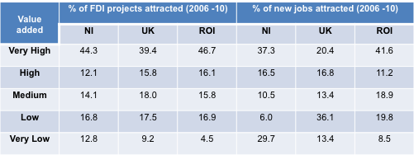
Foreign Direct Investment (FDI)
crucial for Productivity
Telecommunications & ICT; Life & Health Sciences;
Agrifood; Advanced Materials; Advanced Engineering; (MATRIX sectors)
Also for utility of reduced Corporation Tax rate from 1st April 2018 and the changing the effective rate of doing business across border with ROI and gaining advantage of all-Island market and beyond in EU;
Especially the case in examining the role of Global Values Chains (GVCs) in integrating economic activities in a large economic space.

Slide 7
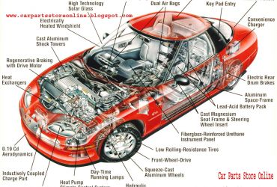
TESLA’s GVC

Slide 8
Possible post-Brexit Trade
Deals
Re-structured EU (but only after French and German Elections, 2017);
European Economic Area (Norway Model);
European Free Trade Agreement (EFTA, Switzerland);
Comprehensive and Trade Agreement (CETA, Canada);
World Trade Organsation (WTO) rule-based bi-lateral deals;
BUT Northern Ireland different to rest of UK because of ROI

Slide 9

Outcomes:
The Matryoshka Doll?

Slide 10
The Border Paradox
?

